Slide 1


Tools for adapting game mechanics and mixed-initiative level design
Riemer van Rozen, Daniel Karavolos, Stefan Leijnen

Slide 2
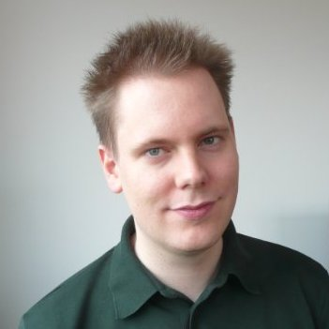


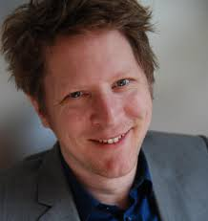
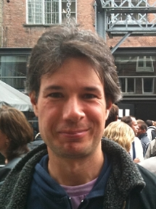
Presenting
Riemer van Rozen | Domain-Specific Languages: ideal PCG targets for mixed-initiative model-driven game development? | Software Engineer
Daniel Karavolos | How to preserve PCG content in a Mixed-Initiative Game Design Process? | Machine Learning
Stefan Leijnen | How to automatically generate emergent gameplay mechanics? | Computational Creativity
Not here
Joris Dormans | Ghost in our Research Machinations Framework Ludoscope | MII Lecturer at Leiden University
Anders Bouwer | Automated Game Design Project Manager and Symposium Organizer | MIE
Notes:
MII = Missing in Industry, and at Leiden University
MIE = Missing in Education: teaching
We are all in the Automated Game Design project:
Gain knowledge on development of games and automated game design.
Practically oriented, cooperation with industry.

Slide 3
Games, Languages, Models & Tools
prototype
maintain
Reusable Applicable
Prototypes
Picked up by Industry
Meta Programming
Language
Workbench
engineer
author
analyze
understand
modify
gameplay
Creative Modeling
Tool
Mixed-Initiative
Model-Driven Game Design
designer
Content Language
Model
Levels
Behavior
Mechanics
Missions
Objects
Narrative
modify @run-time
gameplay
Emergent
Properties
Game Playing
Game
play
player
Notes:
Challenges.
1. Quality. We wish to learn how to develop high quality games: software & gameplay.
2. Expressiveness. Languages and tools can be used to create, generate and maintain game parts, that when composed form a game.
Domain-specific languages can be used to separate concerns between artists, designers and AI programmers,
Language design patterns: compilers, interpreters and pipelines.
3. Preserve generated content.
4. Immediate Feedback. Need for live languages, Modifications @runtime.
5. Predicting emergence. Gameplay emerges from interaction with game software.
6. Maintenance. Since technologies and requirements change all the time so must tools.
Language workbenches such as Xtext, Jetbrains MPS and Rascal MPL are great prototyping tools for languages and tools.
7. Applicable &reusable in Industry.

Slide 4

Domain-Specific Languages: ideal PCG targets for mixed-initiative model-driven game development?
Riemer van Rozen
Amsterdam University of Applied Sciences (HvA),
Centrum Wiskunde & Informatica (CWI)
Software Analysis & Transformation (SWAT) group
Notes:
Model-driven, Mixed-initiative
Languages, Tools
Patterns
Generation, Transformation

Slide 5
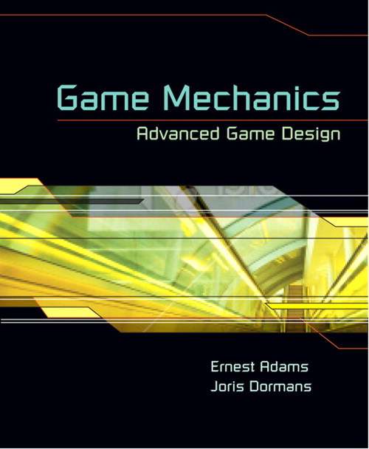
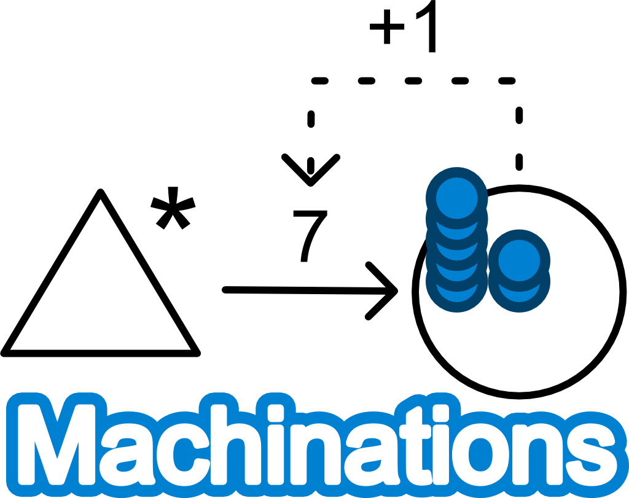
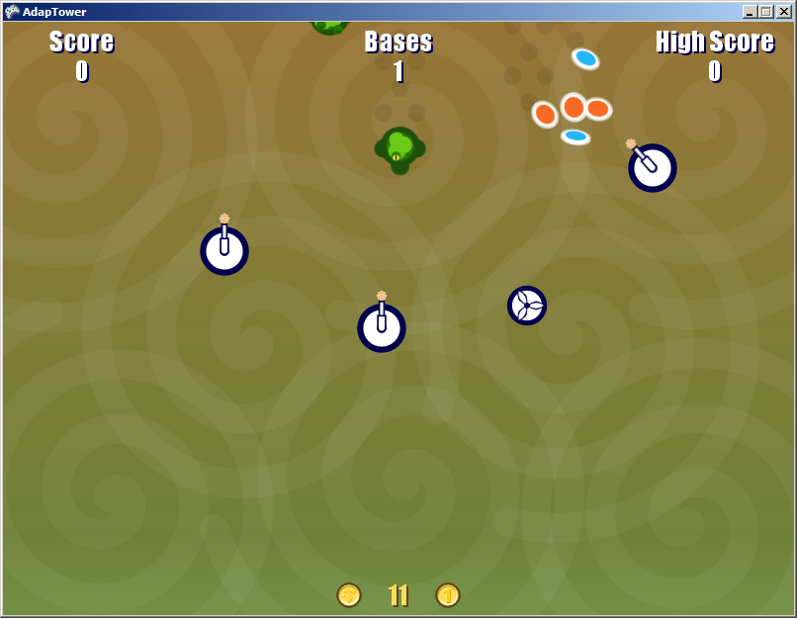
Machinations Language Evolution
Game Design Aid
Prior work of Ernest Adams and Joris Dormans
Conceptual Game Design Framework
Analyze Micro-Machinations
Prior work with Paul Klint [SLE2013]
MM formalizes Machinations’ meaning and extended the language
Added textual notation
Live Adaptations
Prior work with Joris Dormans [FGD2014]
Micro-Machinations is a language and embeddable library that enables game designers to modify a game’s mechanics at run-time
https://github.com/vrozen/MM-Lib
Ernest Adams
Joris Dormans
=
auto source s
pool p at 7
flow: s -p-> p
Modify
Modify
gameplay
Player
Designer
Game Software
Notes:
Brief explanation of what went before.

Slide 6
PCG with Micro-Machinations
Assumption
MM can encode mechanics patterns in software
nodes, edges represent roles
structure represents intent
Missing empirical evidence
Example: Stopping Mechanism
Participants
Nodes: A, acquire, B
Edges: cost, yield
Intent
“Reduce the effectiveness of a mechanism every time it is activated.”
+1
A
acquire
B
Stopping Mechanism [Dormans 2012]

Slide 7
PCG with Micro-Machinations
Implications
Mechanics patterns can be mined in software and automatically recognized
Example Static Analysis
Does the example apply the pattern?
+1
A
acquire
B
Stopping Mechanism [Dormans 2012]
+1
10
5
gold
acquireDefense
defense
5
acquireAttack
attack

Slide 8
PCG with Micro-Machinations
Implications
Mechanics patterns can be mined in software and automatically recognized
Example Static Analysis
Does the example apply the pattern?
Found it.
+1
A
acquire
B
Stopping Mechanism [Dormans 2012]
+1
10
5
gold
acquireDefense
defense
5
acquireAttack
attack

Slide 9
PCG with Micro-Machinations
Implications
Mechanics patterns can be applied
Models can be automatically generated using ‘informed’ decisions
Example Transformation
Can we apply stopping to the example?
Smallest addition.
+1
A
acquire
B
Stopping Mechanism [Dormans 2012]
+1
10
5
gold
acquireDefense
defense
5
acquireAttack
attack
+1

Slide 10
PCG with Micro-Machinations
Generic mechanics patterns
Parameterized
Instead of 1+B and 1 expression parameters E1 and E2
B is a param of E1, (B)=>E1
Constrained
Invariants: E1 > 0 and E2 > 0
E1 monotonically increasing: E1(n) < E1(n+1)
Contribution in Progress
Algorithms for MM Analysis and Generation
Graph matching is expensive!
Prototype Mixed-Initiative Model-Driven Game Design Tool
Patterns as fitness functions?
+1
A
acquire
B
Stopping Mechanism [Dormans 2012]
pool A
user converter acquire
pool B
cost: A-1+B->acquire
yield: acquire -1-> B
pattern stopping (E1, E2)
{
pool A
user converter acquire
pool B
cost: A –(B)=>E1-> acquire
yield: acquire -E2-> B
}
Notes:
Problem: this pattern notation is not generic.
Solution: parameterize edge expressions and constrain them.
Problem: we can generate MM, but how to assess?
Solution? Patterns as fitness function for generating mechanics.

Slide 11
Mixed-initiative level design with Ludoscope
Procedural content preservation Daniël Karavolos

Slide 12
Research Questions
How can we balance the roles of the designer and the computer?
How can we preserve parts of the generated content that we like, while continuing the search for the optimal solution?

Slide 13
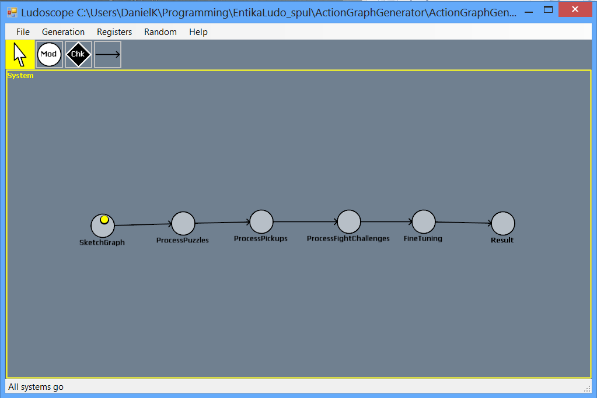
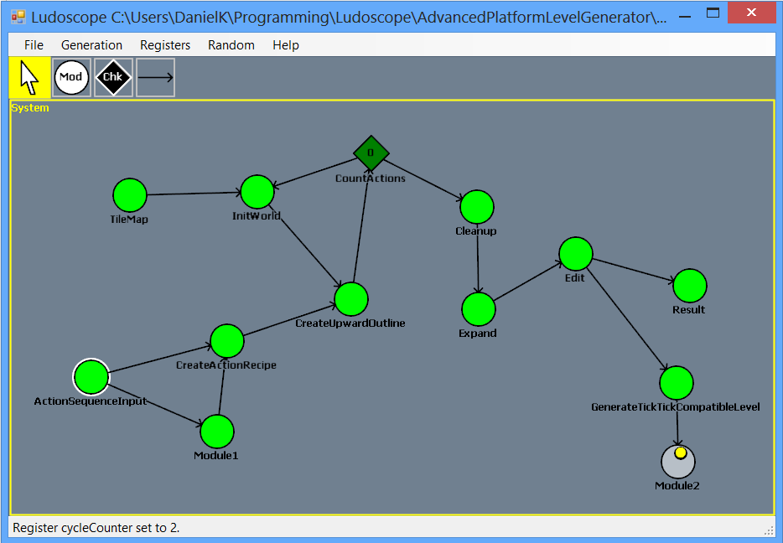
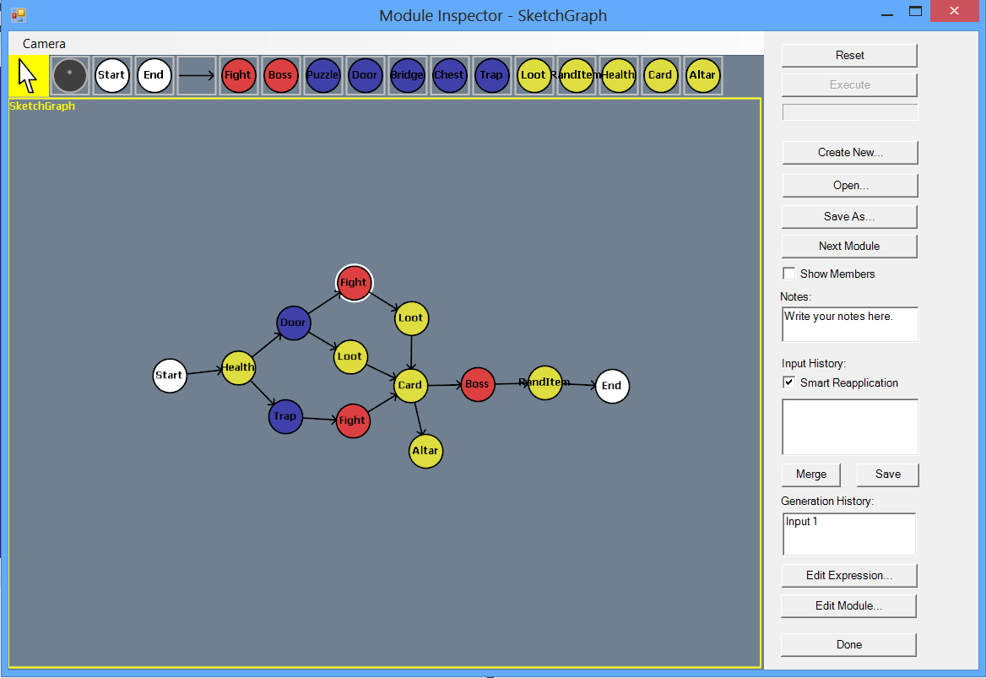
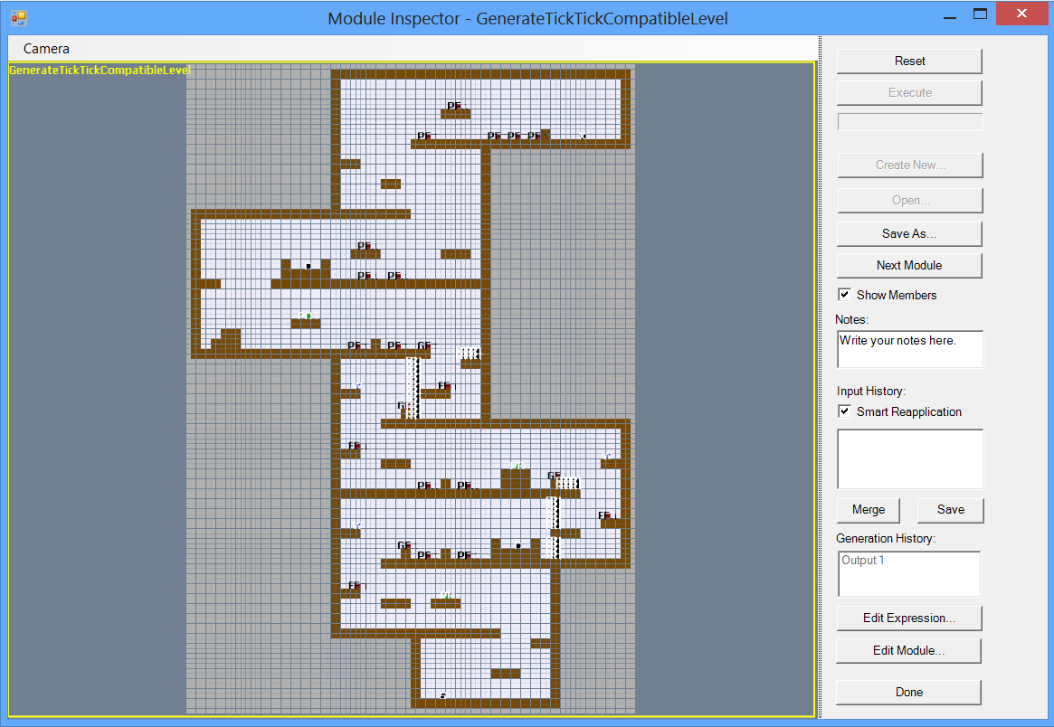
Ludoscope
Dormans, J. (2012). Engineering emergence: applied theory for game design. Creative Commons.
Notes:
I use LudoScope (a software tool created by Joris Dormans).
Create a model of the design process. Modules adapt the content based on (generative) grammars.
For those who don’t know: think of transformation rules, rewriting one term into another (or two). Either run the whole system or iterate through each module.

Slide 14
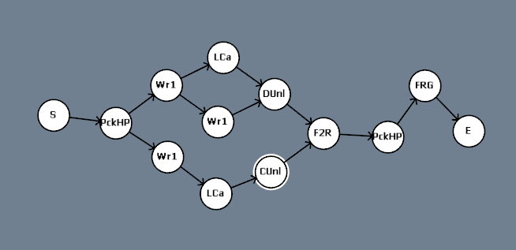
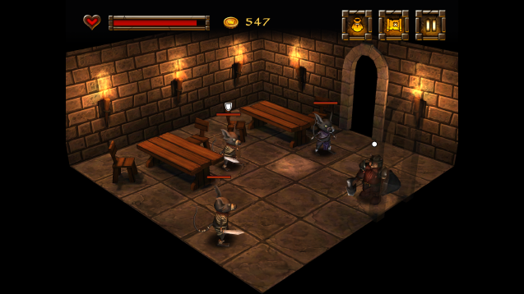
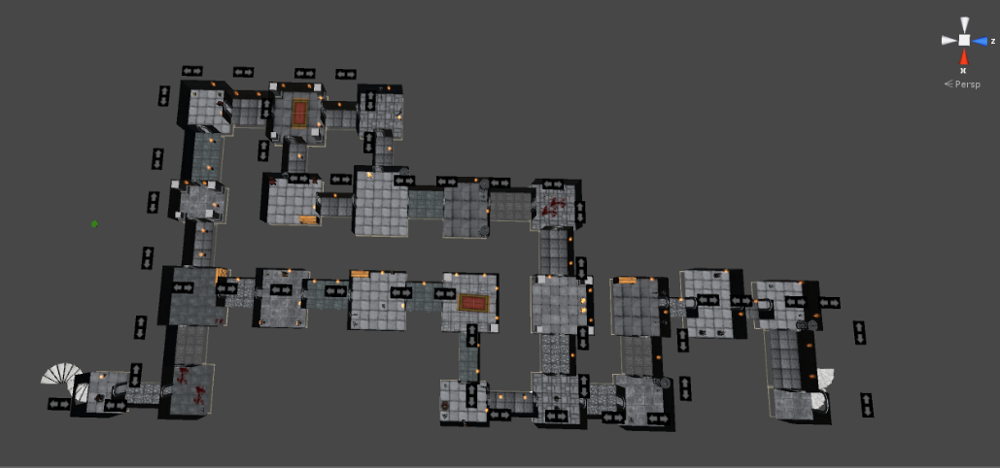

Case Study: Quest-based dungeon generation
Dwarf Quest (2012) by Wild Card Games
van der Linden, R., et al. (2013). Designing Procedurally Generated Levels. In: Proceedings of the second workshop on Artificial Intelligence in the Game Design Process.
Notes:
Inspired by the mission-space generator for adventure games of Joris Dormans, in which the quest of the level and the map are generated separately, but simultaneously, and finally put together. Quests are shaped by three parameters: branching complexity, length, and difficulty.

Slide 15
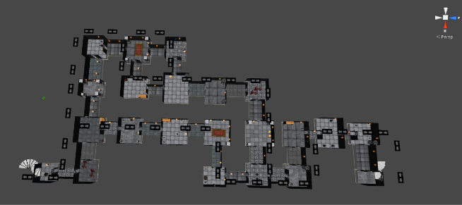
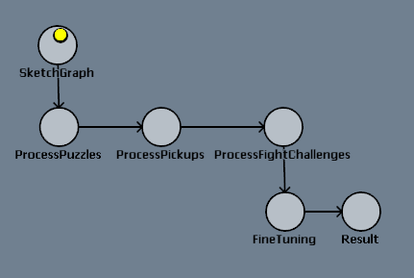
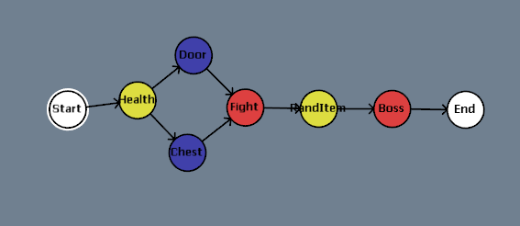
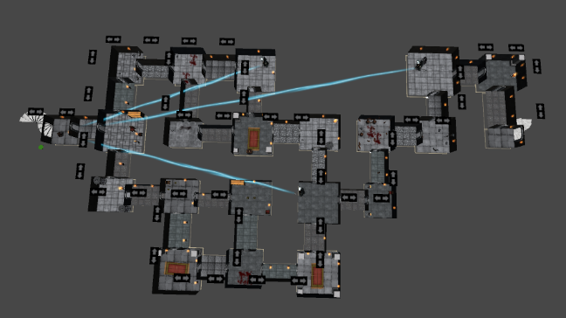
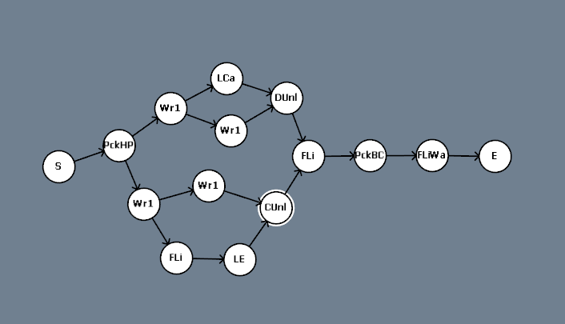
Case Study: Quest-based dungeon generation
With Ludoscope
Graph (difficulty: 2)
Top-down view
Model
Sketch
Graph (difficulty: 9)
Notes:
Since there is a model of the process, you can restart from a certain step in the process, if you don’t like the design. Or make manual adaptations to the final graph. If you use a set random seed, the generator will create the same dungeon, except for the new parts.

Slide 16
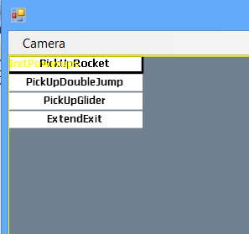
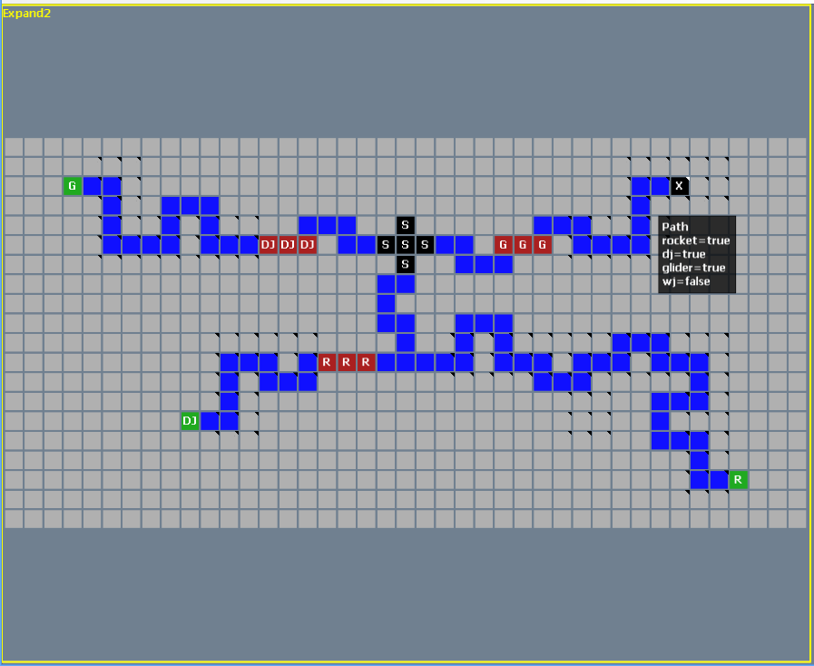
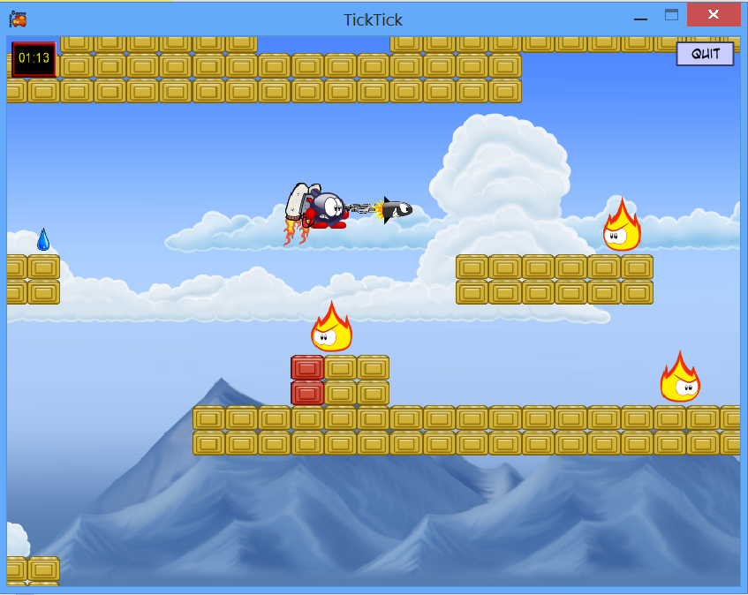
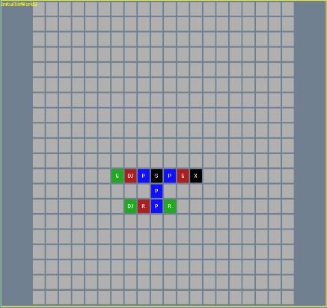
Case Study: Metroidvania Platformer

Slide 17
Considerations
Balance between designer and computer - Degree of control : mixed-initiative vs. parameterization
Notes:
Parameterization vs Mixed-initiative : Naast elkaar bestaan, maar andere doelgroep? (long vs short dev cycle)
- interactive sketchbook vs. one button systems
- Tasks: create variation vs. check designer content

Slide 18

Stefan Leijnen
(almost) PhD in AI: Creativity & Constraint in Artificial Systems
Game Design Research
Lecturer

Slide 19
Research Question
How to automatically generate emergent gameplay mechanics?
Emergence is often ignored at the level of models and tools
But: what exactly is emergence?
Expanding gaming possibilities while maintaining some constraints
Notes:
emergent properties worden vaak genegeerd op het niveau van modellen en tools, behalve bij emergent gameplay
emergent gameplay is niet zomaar het antwoord: meer mogelijkheden is niet per se leuker. Het gaat om een uitbreiding van mogelijkheden binnen een bepaald gedeelte van de zoekruimte. Emergent dynamics kan een uitbreiding zijn van emergent gameplay, door enerzijds een verruiming te bieden en anderszijds te garanderen dat die verruiming aan bepaalde (vooraf bekende) eisen voldoet. ← interessant oplossing
Uitgangspunt: emergent gameplay vs emergence in nature: ik kom vanuit het tweede, en eenmaal terecht gekomen in games, zie ik een verschil met ideeen over vrijheid van de speler (m.n. het tweede dus). Hier zal ik kort wat over vertellen in het kader van design space. Slide: emergent gameplay: zoekruimte wordt gecreeerd met assen (open world possibilities)
BELANGRIJK: why is this PCG? ←------------
Idee: praten over zoekruimtes in games: the possible and the adjacent possible
1) eerst juul over emergent gameplay (meerdere assen van mogelijkheden die onstaat (op macroscale) door combinaties van factoren (op microscale)). Voorbeeld: minecraft. EG: oorspronkelijk van zimmerman (rules of play)
2) dan emergentie in de natuur (self-simplification, self-enforced constraint on a macroscale by amplification on a microscale
flocking als voorbeeld
3) flocking is een voorbeeld van NPC’s, maar ik ben benieuwd of we deze kennis / voorbeelden van natural emergentie ook kunnen toepassen op game mechanics / het game design
4) oob als voorbeeld
5) wat wil ik bereiken: tooling / voorbeeldgame. Wat voor tool: automatisch game design, design support, metrics over mechanics (bv machinations), bouwstenen aanpask
emergent properties worden vaak genegeerd op het niveau van modellen en tools, behalve bij emergent gameplay
emergent gameplay is niet zomaar het antwoord: meer mogelijkheden is niet per se leuker. Het gaat om een uitbreiding van mogelijkheden binnen een bepaald gedeelte van de zoekruimte. Emergent dynamics kan een uitbreiding zijn van emergent gameplay, door enerzijds een verruiming te bieden en anderszijds te garanderen dat die verruiming aan bepaalde (vooraf bekende) eisen voldoet. ← interessant oplossing
algemeen probleem: dit gaat niet over generation, maar over handmatig design. Hamvraag: hoe te designen for emergent properties, en waarom?
emergence (gamplay) leads to interesting games. Geldt dit dus ook voor emergent dynamics?
MAAR
paradox over propositie:
emergent gameplay: vrijheidsgraden worden gecreeerd door combinaties van mogelijkheden
emergent dynamics: vrijheidsgraden worden geelimineerd door zelf-organisatie
hoe zit het nou? Antwoord: meer lezen over emergent gameplay en model opstellen
TODO
- artikelen lezen, m.n. over emergent gameplay. Nadenken over propositie
feedback:
moving into games, en vragen aan het eind: doet jezelf te kort, geen beginner → meer vragen: what am I missing
refs korter
slide research: opdelen in drie slides (plaatje + evt tekst/ref)
----afsluitende slide: daar drie plaatjes en drie refs
this direction → expliciet use keywords
bv. related work in similar fields? ipv 2e vraag
link met games benadrukken
futher notes:
Emergent gameplay: uit rules of play (zimmermann?)
= een niet als zodanig ontworpen speel
Ook lezen / bellen: joris (over machinations)
Voorbeeld minecraft
E G ontwerp: ontwerp van bouwstenen waarmee e g kan ontstaan
algemeen probleem: dit gaat niet over generation, maar over handmatig design. Hamvraag: hoe te designen for emergent properties, en waarom?
emergence (gamplay) leads to interesting games. Geldt dit dus ook voor emergent dynamics?
MAAR
paradox over propositie:
emergent gameplay: vrijheidsgraden worden gecreeerd door combinaties van mogelijkheden
emergent dynamics: vrijheidsgraden worden geelimineerd door zelf-organisatie
hoe zit het nou? Antwoord: meer lezen over emergent gameplay en model opstellen

Slide 20
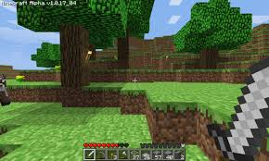
Emergent gameplay
type
space
Notes:
number of ‘macrostates’ grows with dimensions

Slide 21

Emergence in nature
Notes:
minecraft as an example:

Slide 22
Generating Emergent Gameplay
Emergent gameplay
New possibilities are created by combining existing possibilities (increase of degrees of freedom)
Emergence in nature
Existing possibilities are eliminated by self-organization (reduction of degrees of freedom)

Slide 23
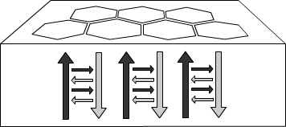
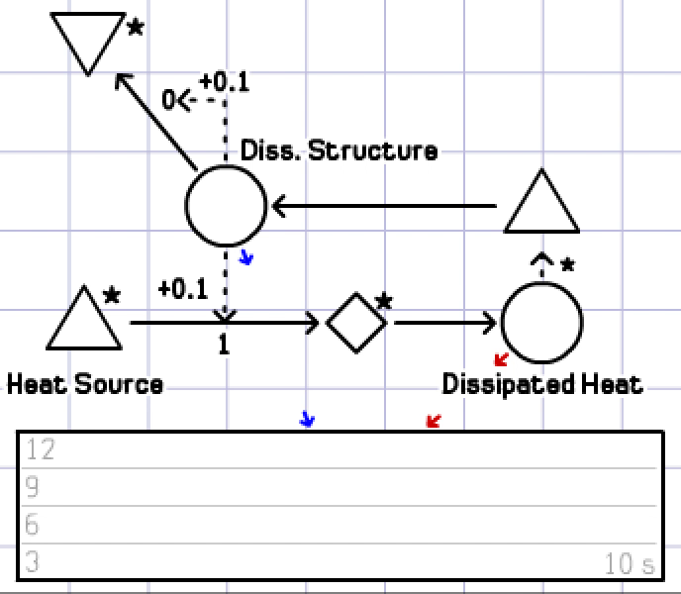
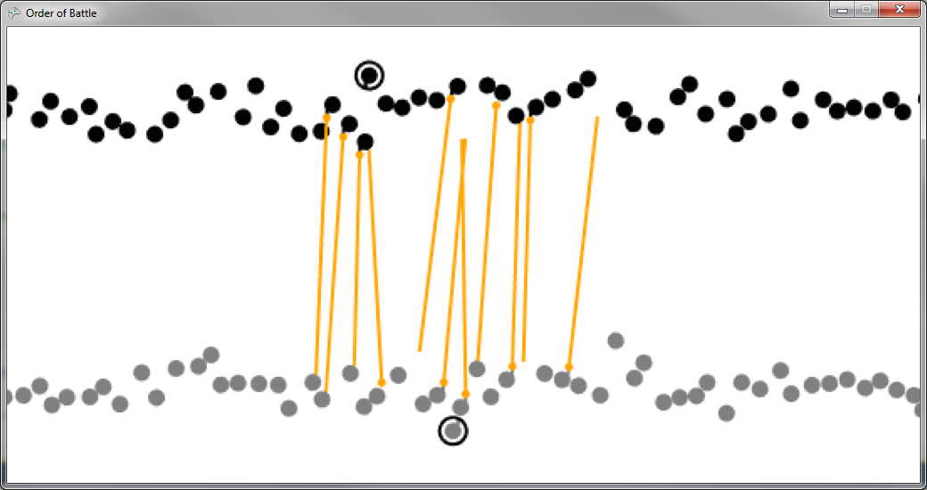
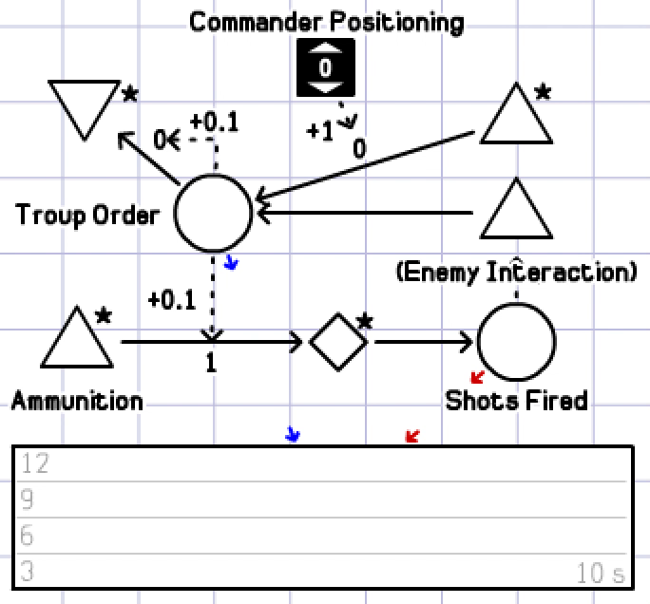
Example
Leijnen, S. and Dormans, J. (2014). Order of Battle: A Case Study for Designing Emergent Structure in Games
Notes:
= example of creating emergent gameplay (by hand) that is modeled after natural emergence

Slide 24
Future research
Next step: automated generation of emergent mechanics
I am looking for
Other people (interested in) working in this direction
Related work in similar fields
Case studies of emergent dynamics in games

Slide 25
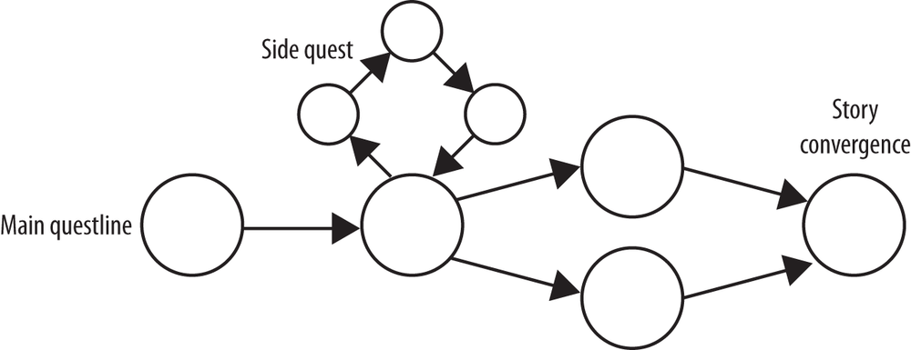
Articles
Dormans, J. and Leijnen, S. (2013). Combinatorial and Exploratory Creativity in Procedural Content Generation. In Workshop Proceedings of the 8th Interna- tional Conference on the Foundations of Digital Games, May 14-17, 2013, Chania, Greece, ISBN 78-0-9913982-1-8.
Leijnen, S. and Dormans, J. (2014). Order of Battle: A Case Study for Designing Emergent Structure in Games. In S. Stepney and P. Andrews (Eds.) CoSMoS 2014: Proceedings of the 7th Workshop on Complex Systems Modelling and Simulation, Luniver Press.
Juul, J. (2002). The Open and the Closed: Game of emergence and games of progression. In Computer Games and Digital Cultures Conference Proceedings, edited by Frans Mäyrä, 323-329. Tampere: Tampere University Press.
Stefan Leijnen, s.leijnen@hva.nl

Slide 26
Riemer van Rozen | Domain-Specific Languages: ideal PCG targets for mixed-initiative model-driven game development? | Software Engineer
Daniel Karavolos | How to preserve PCG content in a Mixed-Initiative Game Design Process? | Machine Learning
Stefan Leijnen | How to automatically generate emergent gameplay mechanics? | Computational Creativity
Oh no, no time for questions!
Want to discuss?
Come find us!

